Slide 1
CIS-ARK and Analytics Data Transfer between ARK and VistA Surgical Scheduling (File 130)
Office of Informatics & Analytics (OIA)
Health Informatics (HI)/Office of the Chief Nursing Informatics Officer (OCNIO)
December 2015

Slide 2
Why is data transferred between ARK and VistA?
ARK Adoption
77 Facilities have adopted ARK’s across 14 VISN’s
4 current vendors – Draeger, iMDSoft, Philips, Picis
Original Goals of the ARKs:
Care Improvements
Workflow Efficiencies
Clinical Documentation
Retrospective Reporting for research, QI,PI
VistA to ARK transfer:
data elements from several packages, for display in ARK
examples: Demographics, ADT, Lab, Pharmacy, BCMA
Purpose of the Workgroup:
Some data can be configured to transfer ARK-to-VistA or VistA-to-ARK
specified fields of Surgical Scheduling package, File 130
direction of flow was set to meet in-the-field clinical workflow in use of ARK and VistA
VISNs and their facilities determined direction of data for each field

Slide 3
Transfer of data between ARK and VistA
Data Transfer Performed by:
DSIH, a component of DSS DataBridge, which transfers data as configured for a facility
ARK application sending/receiving data through DSIH
VistA sending and receiving data to/from File 130
Direction of transfer is labeled from the point of view of VistA:
R = “Receive” by VistA, ARK-to-VistA
S = “Send” by VistA, VistA-to-ARK
Direction of transfer is set for a VistA system
usually one facility, except more than one for an integrated VistA system
settings for a field can not be mixed for a VistA system/facility
settings can differ from one facility to another
settings are stored in parameter files configured with DataBridge
transfer also requires the ARK to process the data
even with the setting to R (data from ARK to VistA), an ARK needs to make the data available for transfer

Slide 4
The fields in File 130 , that can be transferred & Goal of workgroup to establish enterprise settings for each element.
Ref # | Field Name | Field in File 130 |  | Seq # | Field Name | Field in File 130
1 | TIME OPERATION BEGAN | 0.22 |  | 18 | FINAL ANESTHESIA TEMP (C) | 0.65
2 | TIME OPERATION ENDS | 0.23 |  | 19 | END PULSE | 0.84
3 | NURSE PRESENT TIME | 0.202 |  | 20 | END RESP | 0.86
4 | TIME PAT IN HOLD AREA | 0.203 |  | 21 | END BP | 0.85
5 | ANES AVAIL TIME | 0.204 |  | 22 | ASA CLASS | 1.13
6 | TIME PAT IN OR | 0.205 |  | 23 | CASE SCHEDULE TYPE | 0.035
7 | SURG PRESENT TIME | 0.206 |  | 24 | ATTENDING CODE | 0.166
8 | ANES CARE START TIME | 0.21 |  | 25 | REPLACEMENT FLUID TYPE | 0.27
9 | ANES CARE END TIME | 0.24 |  | 26 | INDUCTION COMPLETE | 0.215
10 | TIME PAT OUT OR | 0.232 |  | 27 | ANES SUPERVISE CODE | 0.345
11 | PRINC ANESTHETIST | 0.31 |  | 28 | PGY OF PRIMARY SURGEON | 214
12 | RELIEF ANESTHETIST | 0.32 |  | 29 | SURGEON | 0.14
13 | ASST ANESTHETIST | 0.33 |  | 30 | ATTEND SURG | 0.164
14 | ANESTHESIOLOGIST SUPVR | 0.34 |  | 31 | OPERATING ROOM | 0.02
15 | BLOOD LOSS (ML) | 0.25 |  | 32 | ADMIT PAC(U) TIME | 1.17
16 | TOTAL URINE OUTPUT (ML) | 0.255 |  | 33 | PAC(U) DISCH TIME | 1.18
17 | OR SET-UP TIME | 0.44 |  | 34 | ANESTHETIC TYPE | 130.47
 |  |  |  | 35 | ANESTHETIC TECHNIQUE | 130.06

Slide 5
Dependence of transfer on DSIH
DSIH transfer dependent on parameter file settings
File 133.2
determines formation of S messages – VistA to ARK
used by DSIH and by other transfer mechanisms (LiveData, other)
is subject to known defect to be corrected in patch SR*3.0*186
is maintained by OI&T
DSS and CIS-ARK cannot change settings
DSS introduced File19763.2, due to other COT’s products interfacing to the surgery file.
new file, for use only by DSIH (ARK”s)
explicitly controls transfer of the data, not formation of S message
File 133.2 continues in use, with all fields set to S – send data
this enables settings of File 19673.2 to control S and R
deployed in DataBridge DSIH version 1.6 and later
all ARKs of CIS-ARK program use version 1.6 or later
see diagram on following slide

Slide 6
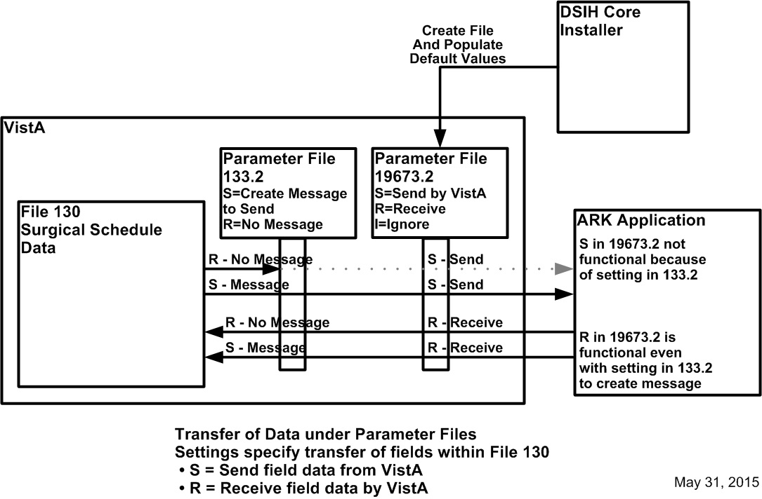
Transfer performed according to settings in parameter files
Transfer direction set in parameter files
File 19673.2 specifies transfer of the data for a field
File 133.2 specifies formation of S data into messages
Send from VistA requires S in both 133.2 and 19673.2
Receive by VistA requires setting in 19673.2; 133.2 immaterial
S = Send by VistA to ARK
R = Receive by VistA from ARK

Slide 7
Other factors in transfer of data
Clinical and Informatics conventions regarding cases can impact data transfer
for surgical cases without a defined start time, VistA substitutes “2:59”
meaning of a concurrent case can differ between Surgery and Anesthesiology
variance in handling of scheduling errors and other exceptions can impact cases
DSIH is dependent on as-is functionalty and data of VistA Surgical Schedule Package
patches can change functionality and cause unanticpated impacts on DSIH
SR*3*171 165 Data issues WHEN USING THE NON-CARDIA V 05/10/10
SR*3*174 166 ANNUAL SURGERY UPDATES – VASQIP V 11/15/10
SR*3*165 167 CPT MODIFIER 51 SCREENING AND SERVICE V11/17/10
SR*3*175 168 ANNUAL SURGERY UPDATES-VASQIP 2011 IN V 08/22/11
SR*3*176 169 SURGERY UPDATES-VASQIP INCREMENT 2 V 06/07/12
SR*3*173 170 RECEIVING ERROR WHEN EXECUTING SRTASK V 07/16/12
SR*3*181 171 INFORMATIONAL - VistA Standardization V 07/16/13
SR*3*177 172 SURGERY ICD-10 CLASS 1 REMEDIATION V 08/15/14
SR*3*178 173 FIX MULTIPLE SURGERY ISSUES V 10/27/14
SR*3*182 174 ANNUAL SURGERY UPDATES – 2014 V 12/22/14
CIS-ARK or Databridge is not part of review of patches before their release
Other known applications that can transfer data to VistA File 130
LiveData
Theradoc

Slide 8
Setting of fields in File 19673.2 for selected facilities
Seq # | Field Name | Field in File 130 | Count of Facilities Field=R
8 | ANES CARE START TIME | 0.21 | 14
9 | ANES CARE END TIME | 0.24 | 14
12 | RELIEF ANESTHETIST | 0.32 | 14
14 | ANESTHESIOLOGIST SUPVR | 0.34 | 14
22 | ASA CLASS | 1.13 | 14
25 | REPLACEMENT FLUID TYPE | 0.27 | 14
26 | INDUCTION COMPLETE | 0.215 | 14
27 | ANES SUPERVISE CODE | 0.345 | 14
11 | PRINC ANESTHETIST | 0.31 | 13
13 | ASST ANESTHETIST | 0.33 | 13
15 | BLOOD LOSS (ML) | 0.25 | 13
16 | TOTAL URINE OUTPUT (ML) | 0.255 | 13
18 | FINAL ANESTHESIA TEMP (C) | 0.65 | 13
30 | ATTEND SURG | 0.164 | 13
1 | TIME OPERATION BEGAN | 0.22 | 12
2 | TIME OPERATION ENDS | 0.23 | 12
3 | NURSE PRESENT TIME | 0.202 | 11
6 | TIME PAT IN OR | 0.205 | 11
10 | TIME PAT OUT OR | 0.232 | 11
31 | OPERATING ROOM | 0.02 | 11
32 | ADMIT PAC(U) TIME | 1.17 | 10
33 | PAC(U) DISCH TIME | 1.18 | 10
Seq # | Field Name | Field in File 130 | Count of Facilities Field=R
34 | ANESTHETIC TYPE | 130.47 | 6
35 | ANESTHETIC TECHNIQUE | 130.06 | 5
5 | ANES AVAIL TIME | 0.204 | 2
17 | OR SET-UP TIME | 0.44 | 1
24 | ATTENDING CODE | 0.166 | 1
4 | TIME PAT IN HOLD AREA | 0.203 | 0
7 | SURG PRESENT TIME | 0.206 | 0
19 | END PULSE | 0.84 | 0
20 | END RESP | 0.86 | 0
21 | END BP | 0.85 | 0
23 | CASE SCHEDULE TYPE | 0.035 | 0
28 | PGY OF PRIMARY SURGEON | 214 | 0
29 | SURGEON | 0.14 | 0
No fields that all facilities write to File 130
22 fields that 10 or more facilities write to File 130 <<these fields can impact the quality of data in File 130
8 fields that no facilities write to VistA <<these fields have no impact on quality of data in File 130

Slide 9
ARK data that can be used by VASQIP
Data transferred to VistA can be used by VASQIP
Values for fields can be
created in ARK
transferred to VistA, File 130
included by VASQIP Phase 3, Data Collection in case assessment
Actual transfer of data shown in the table:
based on settings in File 19673.2 for 27 selected facilities
11 fields are transferred from ARK to VistA, File 130 by one or more facilities<<these are the only fields with values created in an ARK that are included in VASQIP case assessments
Ref # | Field in File 130 | Number of 27 Sample Facilities that transfer the field from ARK to VistA
9 | ANES CARE END TIME | 14
8 | ANES CARE START TIME | 14
22 | ASA CLASS | 14
1 | TIME OPERATION BEGAN | 12
2 | TIME OPERATION ENDS | 12
31 | OPERATING ROOM | 11
6 | TIME PAT IN OR | 11
10 | TIME PAT OUT OR | 11
33 | PAC(U) DISCH TIME | 10
35 | ANESTHETIC TECHNIQUE | 5
24 | ATTENDING CODE | 1

Slide 10
Questions & Comments

